Slide 1

Soil Analyzer Analyse the soil fertility with the essential nutrients present in the soil
SRM INSTITUTE OF SCIENCE AND TECHNOLOGY
SCHOOL OF COMPUTING
DEPARTMENT OF COMPUTING TECHNOLOGIES
18CSP107L - MINOR PROJECT
Guide name: Dr. P. Rama
Designation: Assistant Professor Department: Computing Technologies
Batch ID: 470
Student 1 Reg. No: RA2011003010044
Student 1 Name: Prakash Y
Student 2 Reg. No: RA2011003010125
Student 2 Name: Jagadeesh S

Slide 2
Abstract
In this presentation, we delve into the realm of data-driven agriculture by introducing a novel approach to soil analysis using machine learning. Our project aims to predict soil fertility through the integration of essential nutrients and key soil properties. By harnessing historical soil data alongside factors such as pH, electrical conductivity, organic content, and micro/macronutrient levels, our machine learning model offers a predictive framework for assessing soil health. Through a systematic approach encompassing data collection, preprocessing, feature engineering, model selection, and validation, we empower farmers and land managers with accurate fertility predictions. This presentation sheds light on the potential of modern technology to revolutionize agriculture practices, enabling sustainable cultivation and informed decision-making.

Slide 3
Introduction
As we know, India is the second largest population country in the world and the majority of people in India have agriculture as their occupation. Farmers are growing the same crops repeatedly without trying a new variety of crops and they are applying fertilizers in random quantities without knowing the deﬁcient content and quantity. So, this is directly aﬀecting crop yield and also causes soil acidiﬁcation and damages the top layer. So, we have designed the system using machine learning algorithms for the betterment of farmers.
Agriculture is one of the important occupations practiced in India. It is the broadest economic sector and plays the most important role in the overall development of the country. In the Agriculture ﬁeld machine learning, for instance, is not a mysterious trick or magic, it is a set of well-deﬁned models that collect speciﬁc. This all input data applies to machine learning predictive algorithms to identify the pattern among data and then process it as per input conditions. data and apply speciﬁc algorithms to achieve expected results.

Slide 4
Literature review
Jamshed, Muhammad Ammar. “Analyze Soil Fertility Using Deep Learning Convolutional Neural Networks.” Shanlax International Journal of Arts, Science and Humanities, vol. 10, no. 3, 2023, pp. 1–5.
Offers a broader perspective on soil fertility's dynamics and in creating a predictive CNN model for assessing soil fertility in diverse agricultural contexts.
Pandey, Shobhit & kumar, Yogender & David, Arun. (2020). Research paper soil.
The study conducted between 2012-2014 assessed soil properties at different depths in seven research farms of Allahabad School of Agriculture. Significant findings were obtained, particularly from the Department of Soil Science, indicating the importance of soil health for agricultural sustainability.
Prabhu, Shubham & Revandekar, Prem & Shirdhankar, Swami & Paygude, Sandip. (2020). Soil Analysis and Crop Prediction. International Journal of Scientific Research in Science and Technology. 117-123. 10.32628/IJSRST207433.
The intro highlights soil fertility's importance in Maharashtra's varied soils and the need for efficient crop prediction. Traditional methods are costly and time-consuming, leading to a free automated soil testing system that considers soil fertility and regional precipitation for crop recommendations.
Bhavya Agarwal, Shubham Pokhriyal, Satvik Vats, Vikrant Sharma, Priyanshu Rawat, Madhvan Bajaj, "Crop Prediction Using Ensemble Learning", 2023 5th International Conference on Inventive Research in Computing Applications (ICIRCA), pp.90-95, 2023.
Crop prediction with ensemble learning combines algorithms to enhance accuracy by leveraging their strengths and weaknesses, potentially increasing crop production and revenue with precise recommendations based on environmental factors.
A. Jhansi Swetha, G. Kalyani, B. Kirananjali, "Advanced Soil Fertility Analysis and Crop Recommendation using Machine Learning", 2023 7th International Conference on Trends in Electronics and Informatics (ICOEI), pp.1035-1039, 2023.
This paper aids Indian farmers in crop decisions with machine learning, emphasizing soil health's impact. It introduces a MIT App Inventor mobile app for crop optimization.

Slide 5
Existing System
Deep Learning CNN Model (Jamshed, Muhammad Ammar): This study proposes a deep learning Convolutional Neural Network (CNN) model for assessing soil fertility in various agricultural contexts. This deep learning-based system aims to improve the accuracy of soil fertility analysis.
Traditional Soil Property Assessment (Pandey, Shobhit & Kumar, Yogender & David, Arun): The research conducted between 2012-2014 focuses on traditional soil property assessment at different depths. This existing system relies on conventional soil analysis methods to understand soil health and its impact on agriculture.
Automated Soil Testing System (Prabhu, Shubham & Revandekar, Prem & Shirdhankar, Swami & Paygude, Sandip): The paper introduces a free automated soil testing system that considers soil fertility and regional precipitation. This system aims to provide efficient and cost-effective soil analysis for crop recommendations.
Crop Prediction with Ensemble Learning (Bhavya Agarwal, Shubham Pokhriyal, Satvik Vats, Vikrant Sharma, Priyanshu Rawat, Madhvan Bajaj): This system combines multiple algorithms using ensemble learning techniques to enhance the accuracy of crop prediction. It leverages the strengths and weaknesses of various algorithms to improve recommendations based on environmental factors.

Slide 6
Comparison of Existing Methods with Merits and Demerits
Merits:
Accuracy: Laboratory testing provides accurate measurements of soil properties and nutrient levels.
Standardized Procedures: Established procedures and protocols for soil testing ensure consistency.
Expert Interpretation: Analysis results are often interpreted by trained professionals, offering valuable insights.
Proven Approach: Traditional methods have been used successfully for years in agricultural practices.
Demerits:
Time-Consuming: Laboratory testing and analysis are time-intensive processes, delaying decision-making.
Labor-Intensive: Collecting samples and sending them to labs requires effort and resources.
Limited Spatial Data: Traditional methods might not provide detailed spatial variations in soil properties.
Costly: Lab testing, equipment, and expert interpretation can be expensive.
Subjective Interpretation: Interpretation can vary based on the expertise of the analyst.

Slide 7
Challenges to address
Traditional soil analysis methods address challenges including:
Accuracy and Reliability:
Rigorous laboratory processes and quality control ensure accurate results.
Standardized Protocols:
Established protocols maintain consistent testing procedures.
Expert Interpretation:
Trained experts provide insights and recommendations.
Historical Data:
Soil surveys and historical data inform soil properties.
Local Expertise:
Local agronomists offer region-specific advice.
Sampling Techniques:
Standardized methods ensure representative samples.
Laboratory Infrastructure:
Equipped labs handle comprehensive analysis.
Time-Consuming Analysis:
Though slow, accurate results guide decisions.
High Cost:
Accuracy justifies expenses for improved yields.
Limited Accessibility:
Mobile testing units bridge remote access gaps.

Slide 8
Problem Statement and Objectives
Traditional methods of soil fertility analysis are often time-consuming, labor-intensive, and may lack precision. Farmers and agricultural experts require a more efficient and accurate solution to predict essential nutrient levels (N, K, P, Ca, S), pH, organic carbon (OC), and electrical conductivity (EC) in soil. The absence of an automated system for soil fertility assessment hinders optimal crop growth and yield.
Objective:
The purpose of deploying this project is to revolutionize soil analysis and nutrient management in agriculture. By leveraging advanced technologies like machine learning and data analytics, the project aims to provide accurate and real-time predictions of soil fertility.
This predictive capability will empower farmers to make informed decisions about nutrient application, leading to optimized crop yields, resource efficiency, and sustainable farming practices. Ultimately, the deployment of this project aims to enhance agricultural productivity, reduce environmental impact, and contribute to global food security.

Slide 9
Proposed System
Collect a diverse dataset of soil samples encompassing essential nutrients (N, K, P, Ca, S), pH, organic carbon (OC), and electrical conductivity (EC).
Preprocess the data to handle missing values, outliers, and normalize features for consistent model performance.
Select and implement suitable machine learning algorithms for soil fertility prediction, such as Random Forest or Gradient Boosting.
Train the models using the preprocessed dataset, employing cross-validation and hyperparameter tuning techniques to optimize performance.
Develop a user-friendly web-based interface that allows users to input soil data easily.
Design an intuitive UI with clear instructions, input fields, and interactive elements for an enhanced user experience.
Implement the trained machine learning models in the backend of the system to generate predictions based on user-inputted soil data.
Process the input data through the models to produce predictions for essential nutrient levels, pH, OC, and EC.

Slide 10
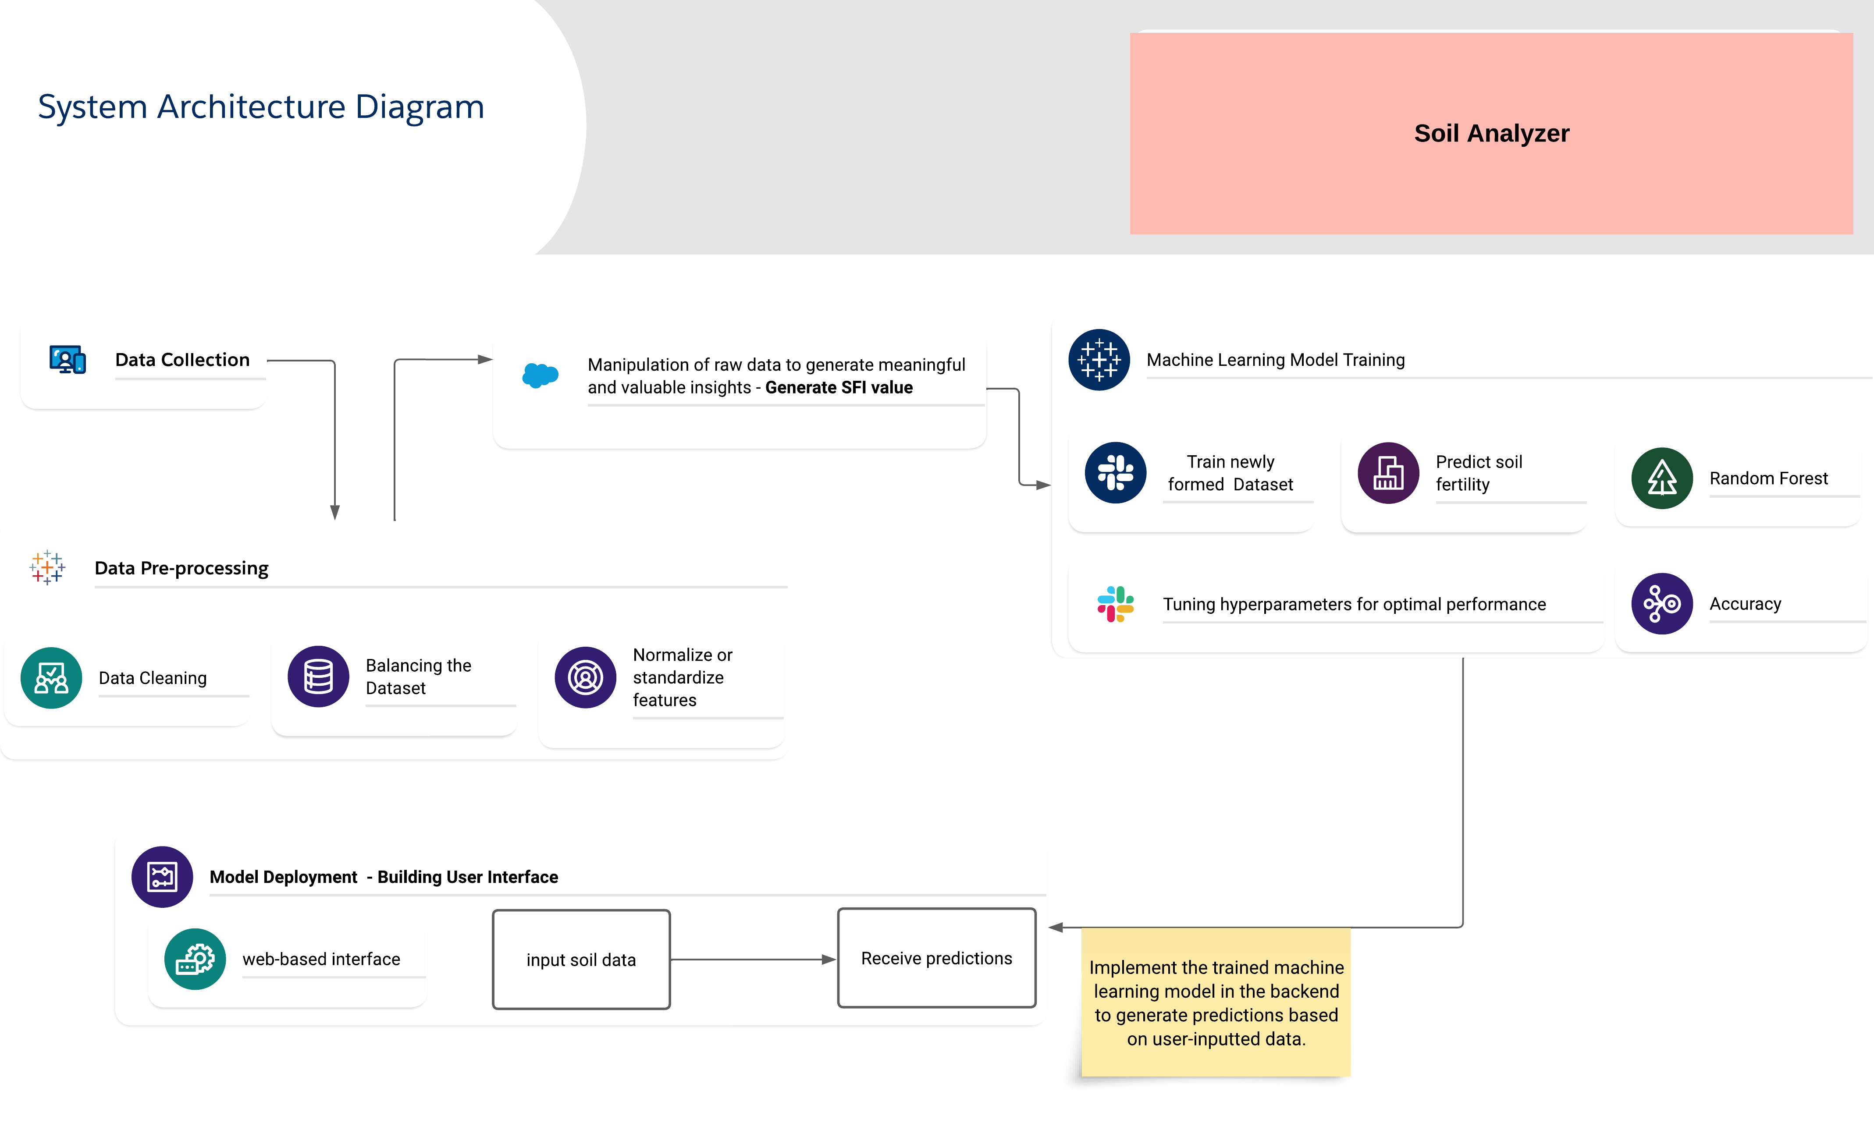
Architecture Diagram of the proposed model

Slide 11
Modules Description
1. Data Collection and Storage:
Gather diverse soil samples with essential nutrients, pH, OC, EC, and other properties.
Store the collected data in a structured database.
2. Data Preprocessing:
Clean the data by handling missing values, outliers, and errors.
Normalize or standardize features to ensure consistent scaling.
3. Generating SFI value:
With the necessary information such as Nutrient Score, pH Score, EC Score, OC Score and Texture Score we can calculate the Soil fertility index score.
4. Machine Learning Model Training:
Choose appropriate machine learning algorithms (Random Forest) for the prediction task.
Split the data into training and validation sets.
Train the chosen models using the training data, tuning hyperparameters for optimal performance.
4. Model Deployment:
Design a web-based interface where users can input soil data and receive predictions.
Create user-friendly input forms with appropriate validations.
Implement the trained machine learning model in the backend to generate predictions based on user-inputted data.

Slide 12
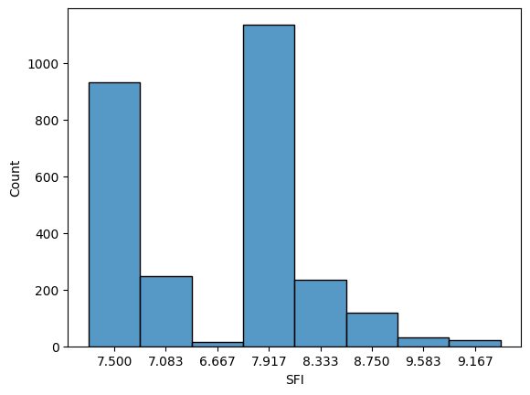
Results and Discussion
The histogram displays the distribution of values in the output column, which ranges from 6.677 to 9.583. By visualizing this data, we can quickly understand how values are distributed within this range, whether the distribution is skewed, where the central tendency lies, and if there are any outliers or patterns. This graphical representation is a valuable tool for initial data exploration and analysis.

Slide 13
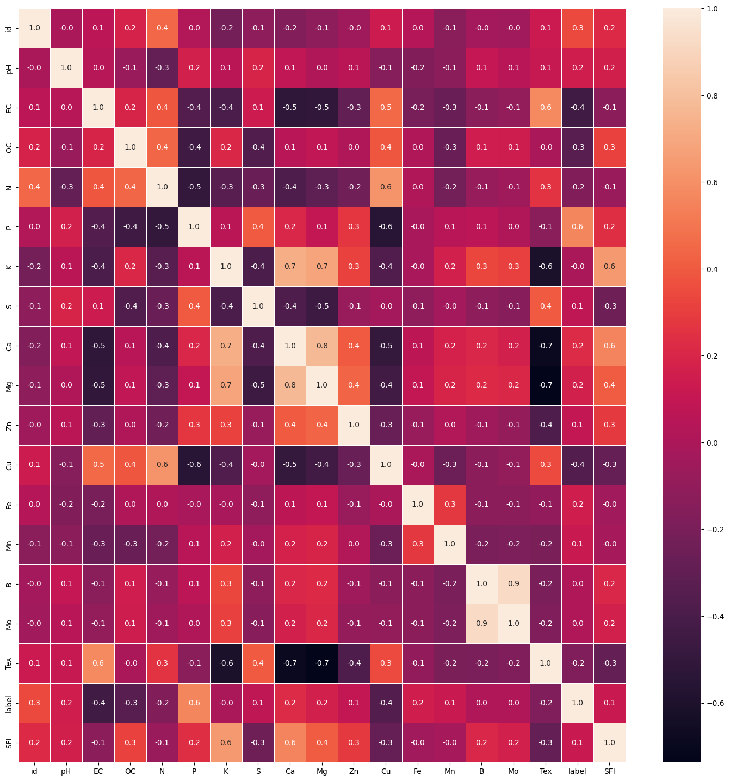
Heatmap:

Slide 14
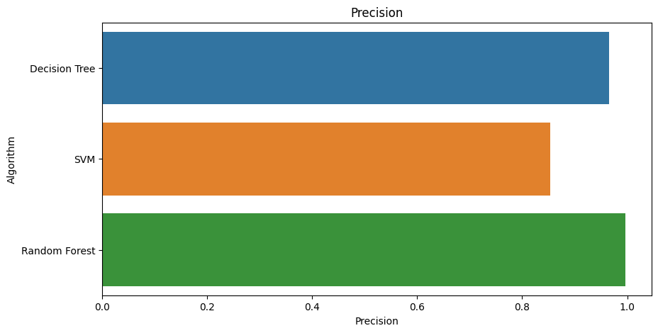
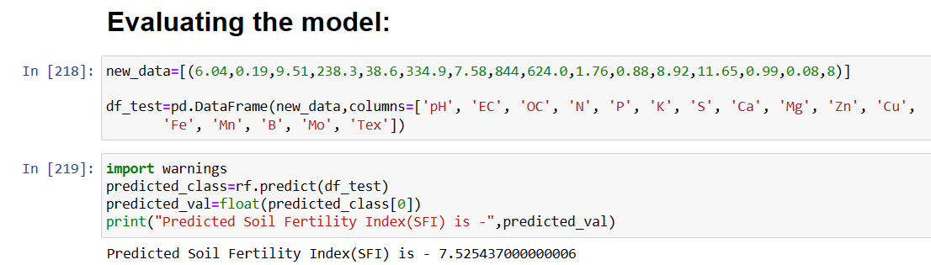
Results

Slide 15
In the provided dataset, which encompasses parameters such as pH, electrical conductivity (EC), organic carbon (OC), and various micronutrient levels, an additional layer of insight has been introduced through the calculation of a soil fertility index.
This index is a synthesized metric that encapsulates the holistic fertility of the soil, merging the individual parameters into a single value. By employing specific formulas and calculations, this index offers a comprehensive evaluation of the soil's fertility status, integrating key factors that influence plant growth and productivity.
The inclusion of the soil fertility index in the dataset enhances its utility by providing a consolidated measure that simplifies decision-making processes related to agricultural practices and resource allocation.
This index becomes an invaluable tool for understanding the overall soil health and determining appropriate strategies for optimizing crop cultivation and land management practices.

Slide 16
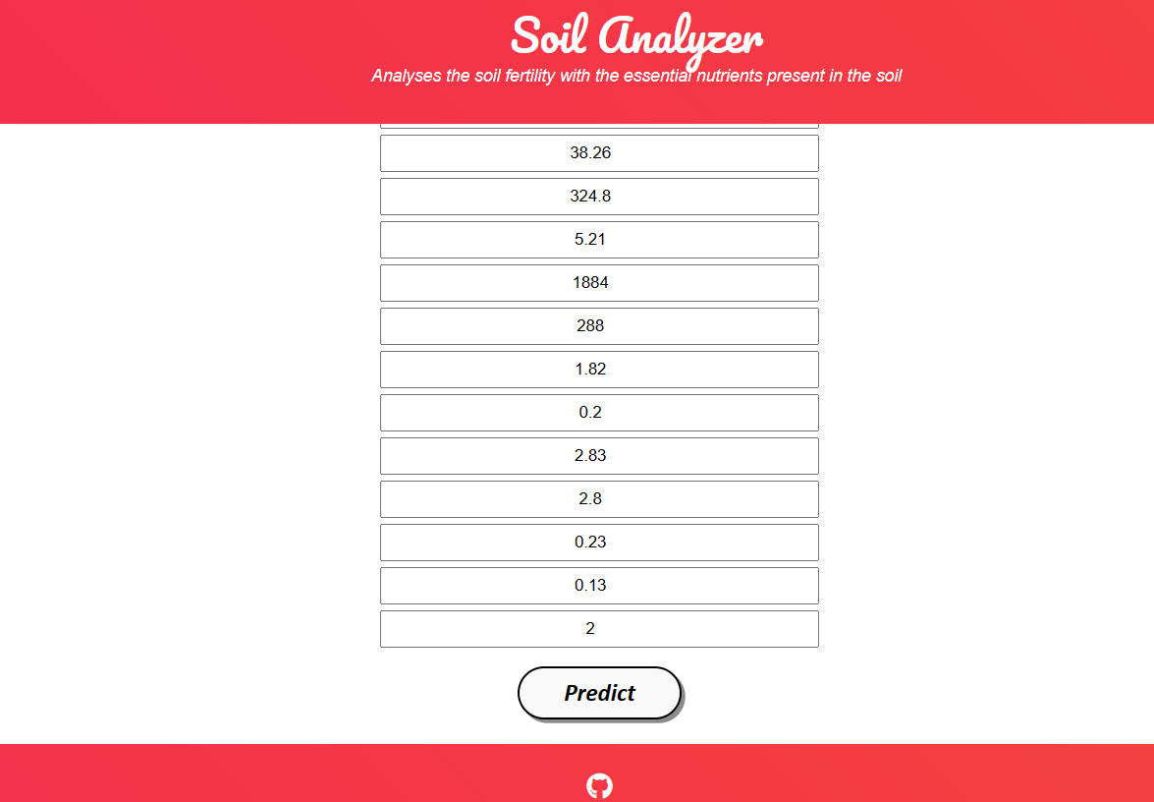
Final Output

Slide 17
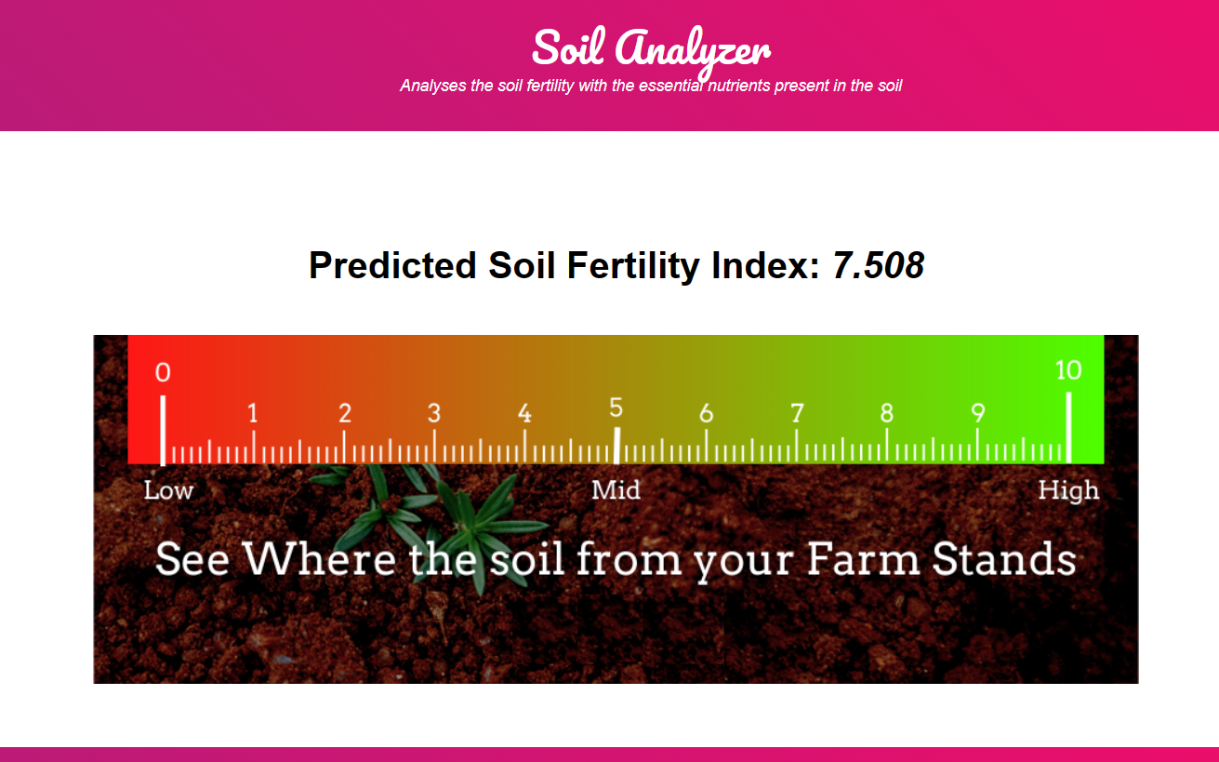

Slide 18
References
Kaggle Dataset prepared by G. B. Pant University of Agriculture and Technology.
Jamshed, Muhammad Ammar. “Analyze Soil Fertility Using Deep Learning Convolutional Neural Networks.” Shanlax International Journal of Arts, Science and Humanities, vol. 10, no. 3, 2023, pp. 1–5.
A Pandey, Shobhit & kumar, Yogender & David, Arun. (2020). Research paper soil.
Prabhu, Shubham & Revandekar, Prem & Shirdhankar, Swami & Paygude, Sandip. (2020). Soil Analysis and Crop Prediction. International Journal of Scientific Research in Science and Technology. 117-123. 10.32628/IJSRST207433.
Bhavya Agarwal, Shubham Pokhriyal, Satvik Vats, Vikrant Sharma, Priyanshu Rawat, Madhvan Bajaj, "Crop Prediction Using Ensemble Learning", 2023 5th International Conference on Inventive Research in Computing Applications (ICIRCA), pp.90-95, 2023.
Jhansi Swetha, G. Kalyani, B. Kirananjali, "Advanced Soil Fertility Analysis and Crop Recommendation using Machine Learning", 2023 7th International Conference on Trends in Electronics and Informatics (ICOEI), pp.1035-1039, 2023.
Josephine Selle Jeyanathan, B. Medha, G. Tharun Venkata Sai, R. Bharath Kumar, Varsha Sahu, "Automated Crop Recommender System using Pattern Classifiers", 2023 International Conference on Intelligent Data Communication Technologies and Internet of Things (IDCIoT), pp.567-572, 2023.
Aditya Motwani, Param Patil, Vatsa Nagaria, Shobhit Verma and Sunil Ghane, "Soil Analysis and Crop Recommendation using Machine Learning", IEEE Conference, 2022.

Slide 19
References
Haedong Lee, Aekyung Moon, Gajeong- ro and Yuseong-gu, "Development of Yield Prediction System Based on Real-time Agricultural meteorological Information", ETRI 218 Gajeong-ro Yuseong-gu, pp. 305-700.
N, Raghu & K N, Manjunatha & B, Kiran & Chetia, Mr & Engineering, Electronics. (2020). COLLABORATIVE RESEARCH IN APPLIED SCIENCE AND ENGINEERING (CRASE) DESIGN AND DEVELOPMENT OF SMART SOIL ANALYSER. 1. 24.
Mot, Andrei & Ion, Violeta & Badulescu, Liliana & Roxana Maria, Madjar & Ciceoi, Roxana. (2022). SOIL QUALITY ASSESSMENT BASED ON C:N RATIO IN AN ALLUVIAL SOIL TREATED WITH MICROBIAL INOCULANTS.
Natarajan, Thangadurai & Sb, Vinay & Chikkalingaiah, Prasanna. (2019). Fertilizer Optimization by an Smart Soil Analyzer with a Soil Tester for Agriculture Applications. International Journal of Advanced Trends in Computer Science and Engineering. 8. 3628-3631. 10.30534/ijatcse/2019/146862019.
Pallevada, Hema & Velagapudi, Engineering & Siddhartha, Ramakrishna & Chandhra, Bharath & Gadde, Sai & Venkata, Teja & Munnangi, Kumar & Chinta, Mukesh. (2021). Real-time Soil Nutrient detection and Analysis. 10.1109/ICACITE51222.2021.9404549.
Lin, J., Wang, M., Zhang, M., Zhang, Y., Chen, L. (2008). Electrochemical Sensors for Soil Nutrient Detection: Opportunity and Challenge. In: Li, D. (eds) Computer And Computing Technologies In Agriculture, Volume II. CCTA 2007. The International Federation for Information Processing, vol 259. Springer, Boston, MA.
Regalado, R G and Jennifer C. dela Cruz. “Soil pH and nutrient (Nitrogen, Phosphorus and Potassium) analyzer using colorimetry.” 2016 IEEE Region 10 Conference (TENCON) (2016): 2387-2391.
Pyingkodi, M. et al. “IoT based Soil Nutrients Analysis and Monitoring System for Smart Agriculture.” 2022 3rd International Conference on Electronics and Sustainable Communication Systems (ICESC) (2022): 489-494.

